Slide 1
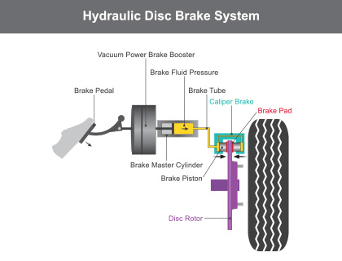
Parts of the Braking System
ABS Control Module. ...
Brake Booster. ...
Disc Brakes. ...
Drum Brakes. ...
Emergency Brake. ...
Master Cylinder. ...
Brake Pedal. ...
Wheel Speed Sensors.

Slide 2
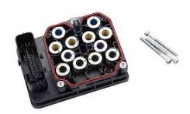
The ABS Control Module is a critical part of the Anti-lock Braking System (ABS) in modern vehicles.
It is responsible for ensuring that the wheels do not lock up during hard braking or on slippery surfaces, thus maintaining traction and steering control.

Slide 3
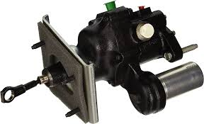
Brake Booster
Uses vacuum or hydraulic pressure to amplify the force applied by the driver to the brake pedal, reducing the effort needed.

Slide 4
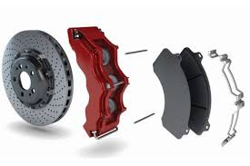
Disc Brakes
Metal discs attached to the wheels that spin with them.
The calipers press the brake pads against these to slow the vehicle.

Slide 5
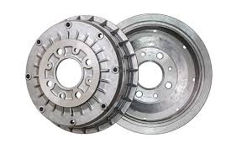
Drum Brakes
Brake Drum: A drum-shaped component that rotates with the wheel.
Brake Shoes: Curved friction surfaces inside the drum that press against it to create braking force.
Wheel Cylinder: A hydraulic cylinder that pushes the brake shoes outward.

Slide 6
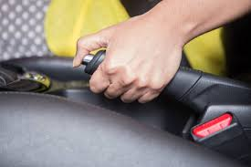
Emergency Brake
A mechanical system (often cable-driven) that operates independently of the hydraulic system to keep the vehicle stationary.

Slide 7
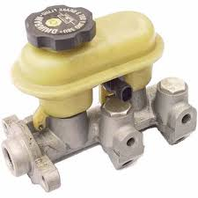
Master Cylinder
Acts as a hydraulic pump that creates pressure in the brake lines when the brake pedal is pressed.

Slide 8
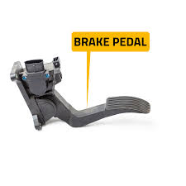
Brake Pedal
The driver presses the brake pedal to initiate braking.
It converts the mechanical force from the foot into hydraulic or mechanical force.

Slide 9
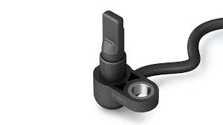
Wheel Speed Sensors
wheel speed sensors, are a critical part of modern vehicle systems, especially in Anti-lock Braking Systems (ABS) and Electronic Stability Control (ESC).
They measure the speed of each wheel and send this information to the vehicle’s control module to improve braking, traction, and overall stability.

Slide 10
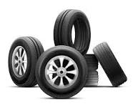
Car repair parts_Tyres
THE INNER LINER.
THE CASING. ...
THE BELTS. ...
THE OVERLAY. ..
THE TREAD. ..
THE SIDEWALL.

Slide 11
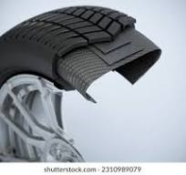
THE INNER LINER
innermost layer of a tire, made from a thin, air-tight rubber sheet, which is responsible for holding air within the tire and is the surface where a repair patch is applied during a puncture repair.

Slide 12
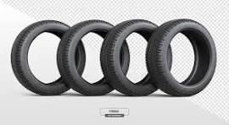
THE CASING
A car tire's casing is the part of the tire that contains the air that supports the vehicle's load.

Slide 13
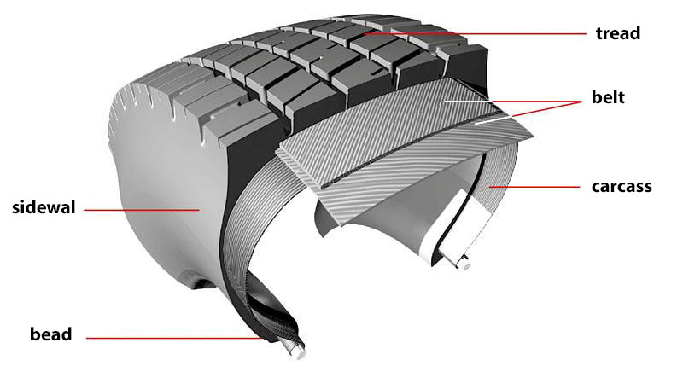
THE BELTS
Belts consist of rubber-coated layers made from materials such as rayon, steel, and fiberglass. Positioned within the tire's midsection, they crisscross at various angles, securely holding the tire plies in place

Slide 14
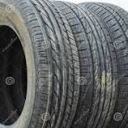
THE OVERLAY
A tire overlay is a layer applied to a tire to improve noise. It is typically applied as a single annular layer around the belt, with the ends of the layer overlapping to create a splice.
However, the slippage at the overlap can cause distortion in the underlying belts.

Slide 15
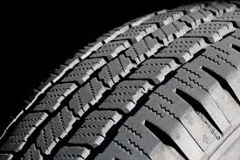
THE TREAD
A car's tire tread is the part of the tire that touches the road and affects the vehicle's handling and grip.
The tread pattern is designed to improve the vehicle's performance for specific driving conditions.

Slide 16
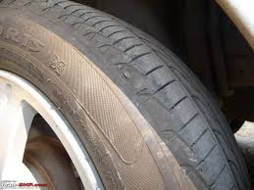
THE SIDEWALL
The Sidewall is the "smooth", vertical area on the side of the tire between the edge of the tread and the bead of the tire, which does not include any area where tread grooves are still visible.

Slide 17
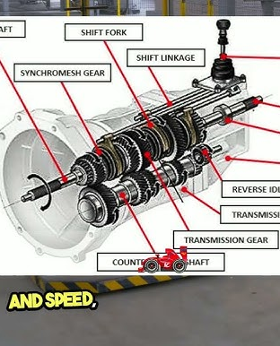
Transmission
Clutch Pedal
Clutch Disc
Flywheel
Pressure Plate
Release Bearing
Gearbox
Input Shaft
Output Shaft
Counter Shaft
Synchronizers

Slide 18
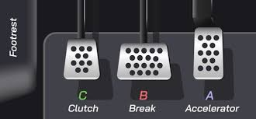
Clutch Pedal
Engages/disengages the clutch to separate the engine from the transmission.

Slide 19
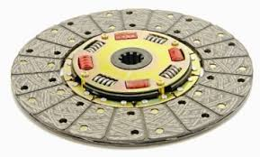
Clutch Disc
Wears out over time due to friction.
Replacement is necessary when it becomes thin or glazed.

Slide 20
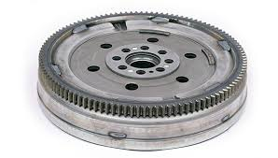
Flywheel
May need resurfacing or replacement if it has cracks or hot spots.

Slide 21
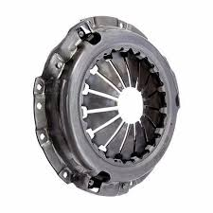
Pressure Plate
May lose clamping force, requiring replacement.

Slide 22
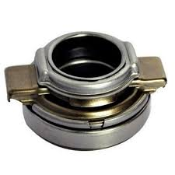
Release Bearing
Can wear out and cause noise when depressing the clutch pedal.

Slide 23
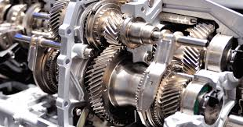
Gearbox
Teeth may wear out or break, requiring replacement.

Slide 24
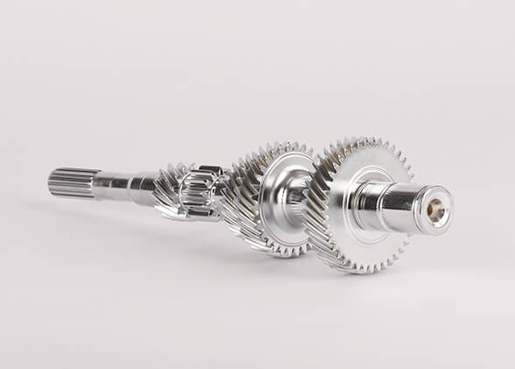
Input Shaft
Receives power from the engine.

Slide 25
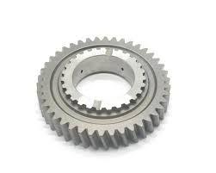
Output Shaft
Transfers power to the differential and wheels.

Slide 26
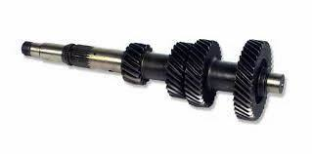
Counter Shaft
Contains the gears that mesh with the input shaft.

Slide 27
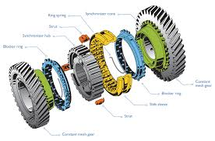
Synchronizers
Allow smooth gear engagement by matching gear speeds.

Slide 28
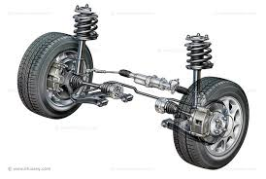
Front Steering and Suspension
The front steering and suspension system is vital for a car's handling, stability, and ride comfort.
Here are the main components typically found in such a system, along with their functions.

Slide 29
Front Steering and Suspension
Steering Components
Steering Wheel
2.Steering Column
3.Rack and Pinion
4.Tie Rods
5.Idler Arm and Pitman Arm
6.Power Steering Pump and Fluid

Slide 30
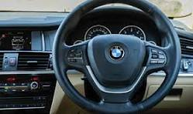
Steering Wheel
The driver uses this to control the vehicle's direction.

Slide 31
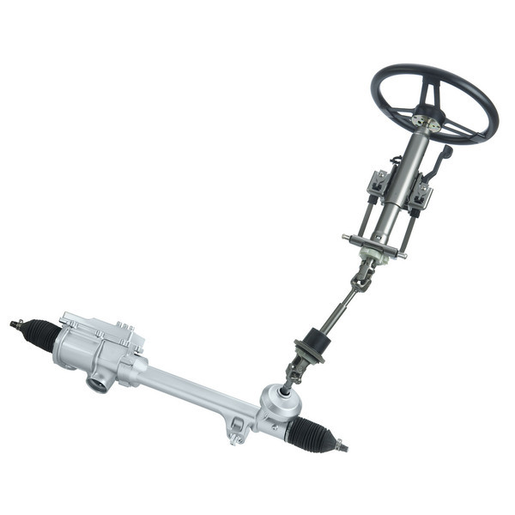
Steering Column
The steering column of a vehicle is the rod to which the steering wheel is attached.
The steering wheel is mounted on a shaft inside the steering column.
The steering column carries the steering inputs to the steering rack or box.
The steering wheel is connected to a shaft that runs through the steering column.

Slide 32
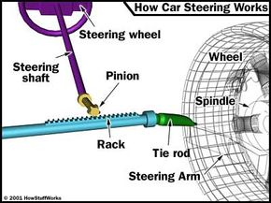
Rack and Pinion
Rack and pinion steering consist of a rack, a long bar with teeth along its length, and pinion gear, a small round gear connected to the steering wheel.
These two components work together to convert the rotational motion of the steering wheel into linear motion that controls the movement of the wheels.

Slide 33
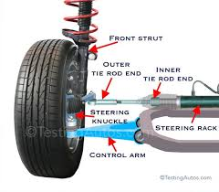
Tie Rods
Tie rods are an integral part of your vehicle's steering.
Just as its name suggests, a tie rod ties your vehicle's steering rack to the steering arm.
The steering arm is attached to the wheel.
There are two types of steering systems: rack-and-pinion steering and re-circulating ball or mechanical steering.

Slide 34
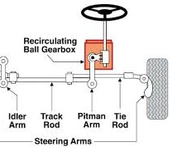
Idler Arm and Pitman Arm
The idler arm and pitman arm are both components of a car's steering system that support the steering linkage and help turn the wheels.

Slide 35
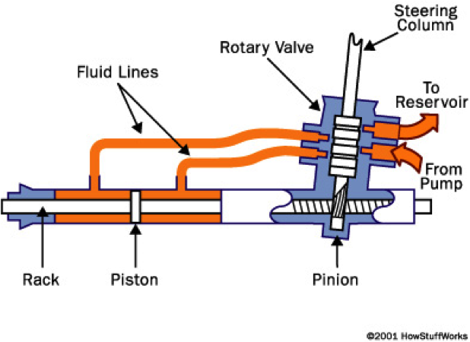
Power Steering Pump and Fluid
A power steering pump is a component in a car that uses a belt-driven mechanism to pressurize hydraulic fluid (power steering fluid).
Which then assists the driver in turning the steering wheel by providing extra force, making it significantly easier to maneuver the car.
This fluid is stored in a reservoir located under the hood and is typically checked as part of regular car maintenance.

Slide 36
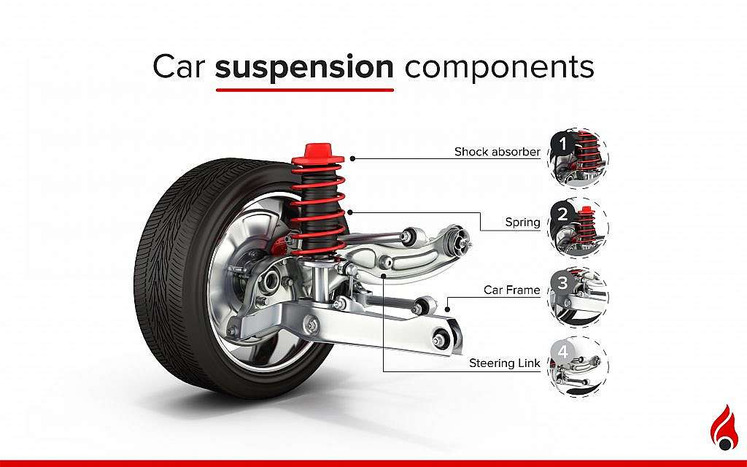
Suspension components
Springs.
Wheels.
Shock Absorbers.
Rods.
Joints, Bearings, & Bushings.
Steering System.
Frame.

Slide 37
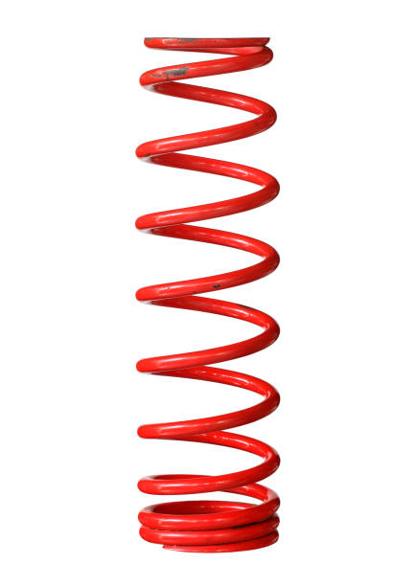
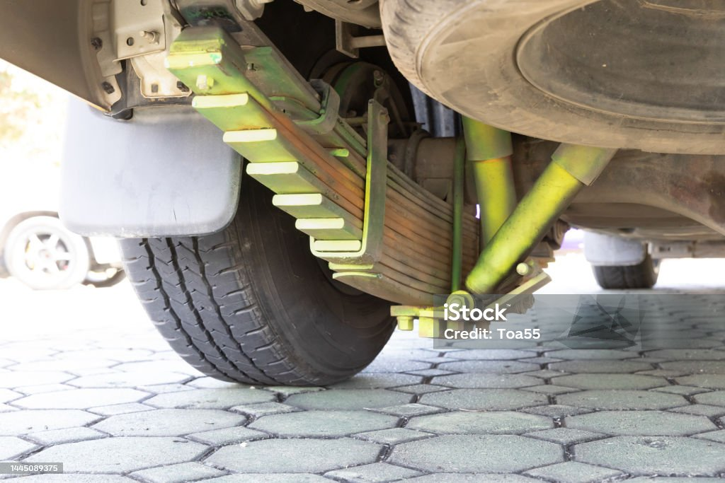
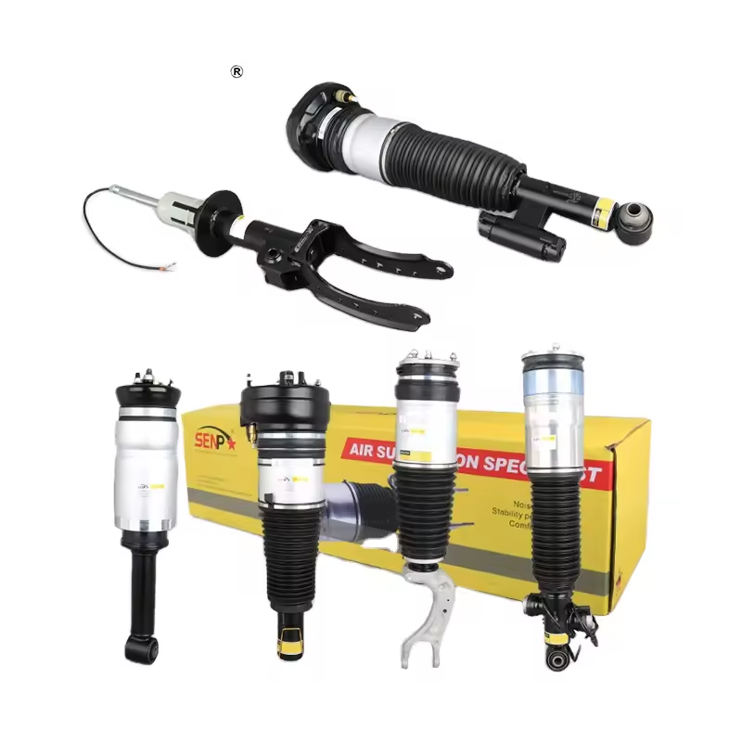
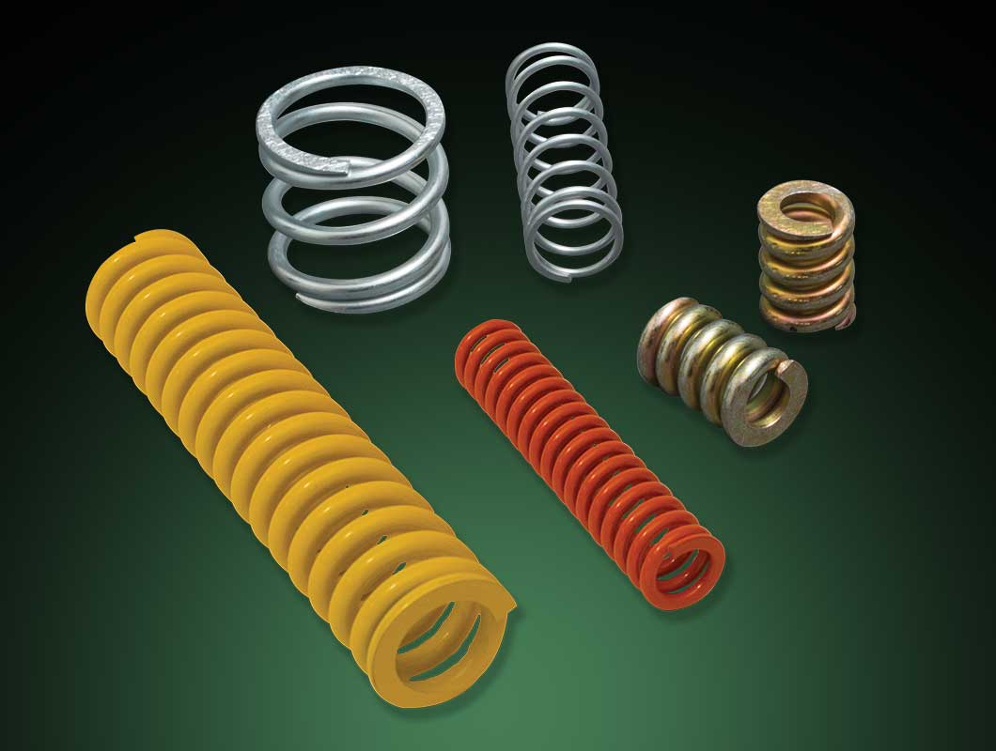
Springs
Suspension springs are the link between wheels and car body.
Their primary task is to compensate uneven road surfaces and thus provide an assurance of high levels of ride comfort.
4 types of springs in a car
Coil springs
leaf springs
torsion springs
air springs

Slide 38
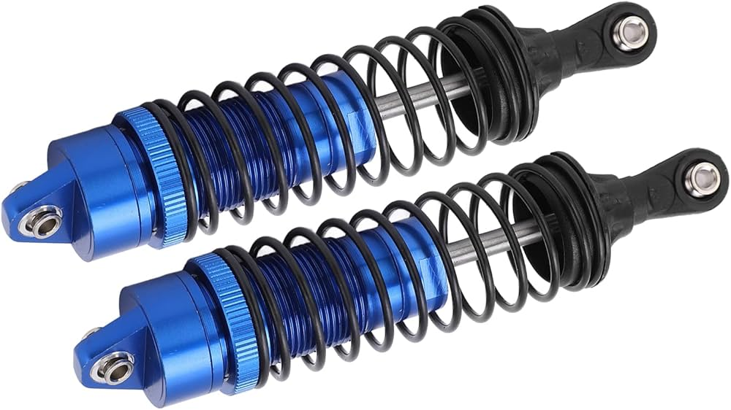
Shock Absorbers
Shock absorbers are mechanical devices that control a vehicle's suspension system and absorb vibrations and shocks from uneven roads.
They are also known as dampers.

Slide 39
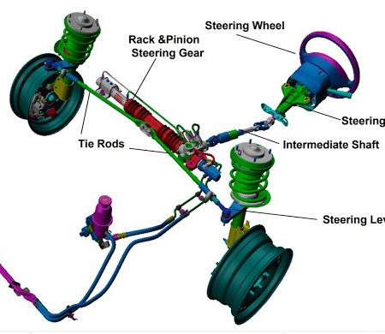
Steering System
A car's steering system is a vital part of the suspension system that allows the driver to control the direction of the vehicle by turning the wheels, essentially acting as the link between the steering wheel and the suspension components that move the wheels to turn the car left or right;
both systems work together to maintain stability and provide a smooth ride on uneven roads.

Slide 40
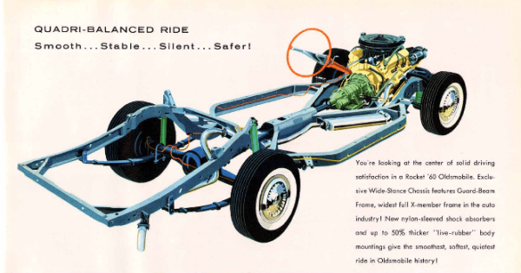
Frame
This frame comprises a rectangular hollow cross-section and a tube that directly passes through for connection between the front and rear suspension.
This creates a human-like skeleton structure.
This chassis frame helps provide better support between the axle and the ground.

Slide 41
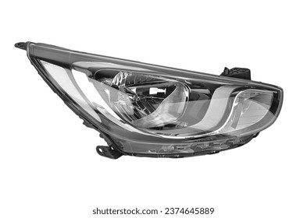
Head Lights
The four main parts of your headlights include the housing, the regular beams, the high beams, and turn signal bulbs. The housing is the hard-plastic cover that you see when you are looking at a vehicle head-on.
The regular beams are what is activated when you turn on your headlights or use your daytime running lights.

Slide 42
Head Lights parts
1.Headlight Bulbs
2. Headlight Assembly
3. Headlight Wiring
4. Ballasts (for HID headlights)
5. Relays and Fuses
6. Adjustment Screws
7. Headlight Switch or Dimmer

Slide 43
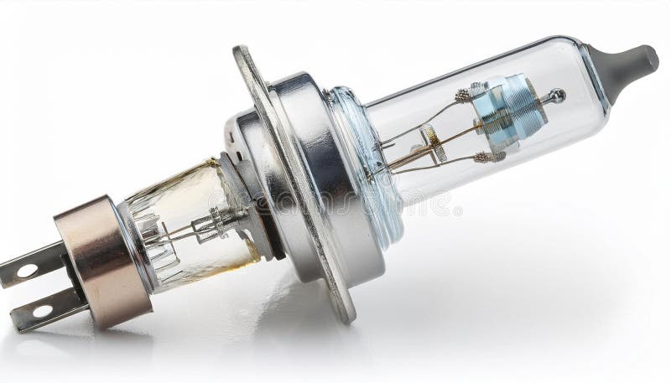
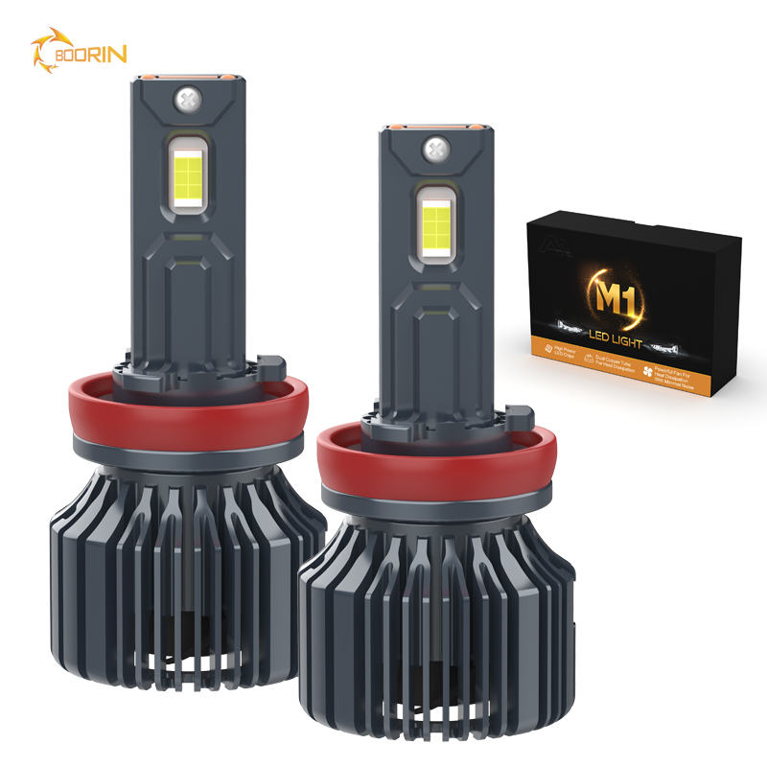
Headlight Bulbs
Halogen, LED, or HID (depending on your car's setup).

Slide 44
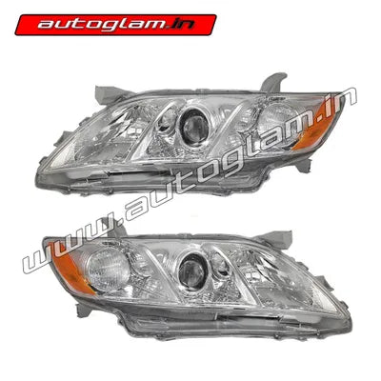
Headlight Assembly
Includes the housing, lens, and reflector.
For replacing cracked or damaged assemblies.

Slide 45
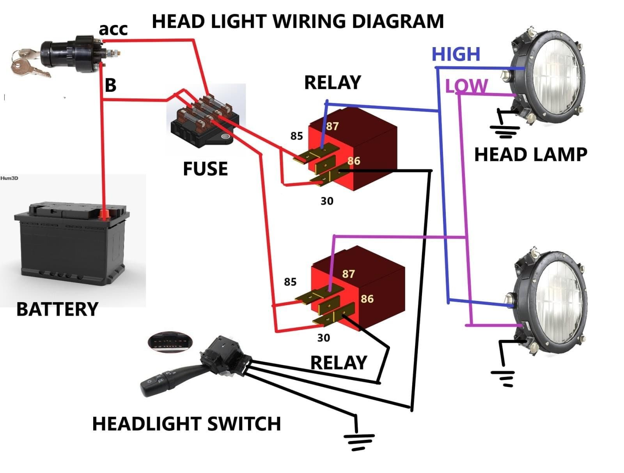
Headlight Wiring
The harness connects the bulbs to the vehicle's electrical system.
Includes power wires, ground wires, and sometimes relays.

Slide 46
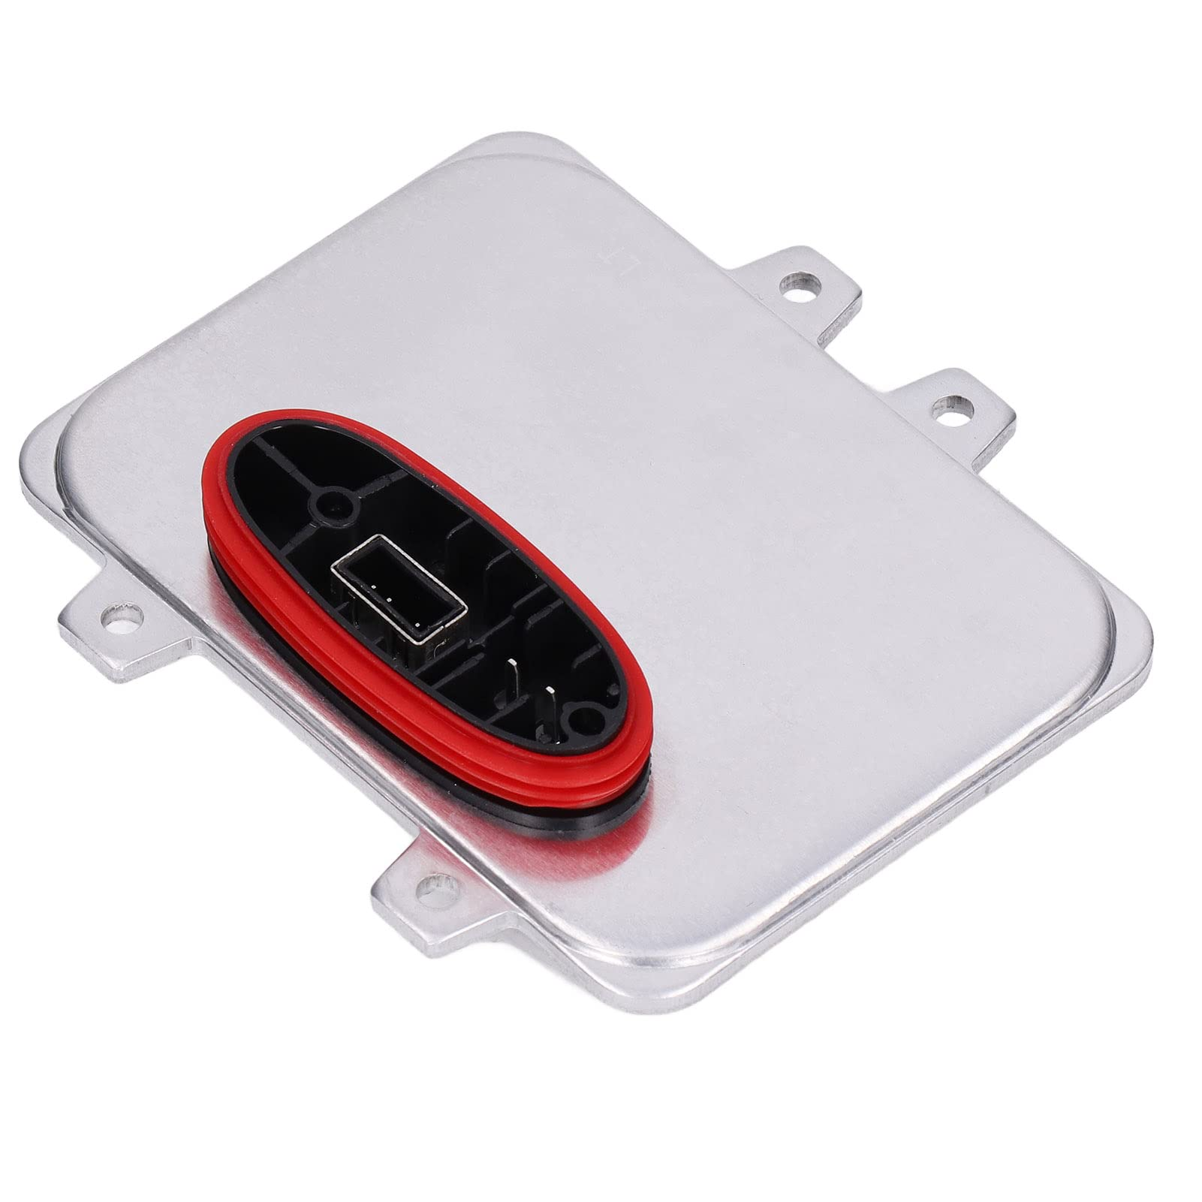
Ballasts (for HID headlights)
A ballast is an electrical component used in HID lighting systems to:
Provide the Initial High Voltage: HID bulbs require a high voltage (around 20,000–25,000 volts) to ignite the arc inside the bulb.
2.Regulate Current: Once the arc is established, the ballast regulates the current and provides a steady voltage (about 85V for most HID systems) to keep the light stable and bright.

Slide 47
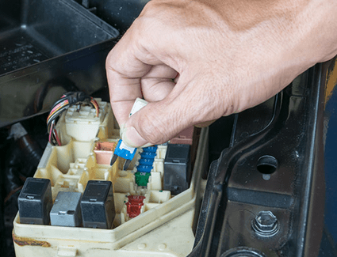
Relays and Fuses
Protects the circuit from short circuits or overcurrent situations.
Often used in modern systems to provide higher power to the headlights while protecting switches.

Slide 48
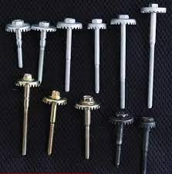
Adjustment Screws
Depending on the model of your car, these screws may be inside the plastic casing or on the top or side of the light housing.
You can usually locate these screws using a Phillips screwdriver. If you can't locate the adjustment screw, you may need to remove the headlight from the car.

Slide 49

Headlight Switch or Dimmer
Corroded connectors, weak ground, or voltage drop in the circuit.
Located inside the vehicle to control headlights (e.g., turning them on, off, or toggling between high and low beams).

Slide 50

WIPERS
Wiper repair parts in cars typically refer to components of the windshield wiper system, which includes several parts responsible for clearing rain, snow, and debris from the windshield.
Here are the main repair parts for wipers:

Slide 51
Wiper parts:
1. Wiper Blades
2. Wiper Arms
3. Wiper Motor
4. Wiper Linkage (Transmission)
5. Wiper Switch
6. Washer Pump
7. Washer Fluid Reservoir
8. Wiper Bushings

Slide 52

Wiper Blades
Description: The rubber or silicone blades that physically wipe the windshield.
Common Issues: Worn out, torn, or streaking.
Repair/Replacement: Usually replaced rather than repaired.

Slide 53

Wiper Arms
Description: The metal or plastic arms that hold the wiper blades and connect to the motor assembly.
Common Issues: Bent, loose, or corroded arms.
Repair/Replacement: Can sometimes be adjusted but often replaced if damaged.

Slide 54

Wiper Motor
Description: The motor that powers the movement of the wiper arms.
Common Issues: Motor failure, overheating, or not responding to controls.
Repair/Replacement: Can be repaired (e.g., rewiring) or replaced entirely.

Slide 55

Wiper Linkage (Transmission)
Description: The mechanism connecting the wiper motor to the wiper arms, allowing coordinated movement.
Common Issues: Broken or disconnected linkages.
Repair/Replacement: Linkage repair kits are available, or the assembly can be replaced.

Slide 56

Wiper Switch
Description: The switch or control (often on the steering column) used to operate the wipers.
Common Issues: Electrical failures or mechanical wear.
Repair/Replacement: Sometimes requires switch or wiring replacement.

Slide 57

Washer Pump
Description: A small motorized pump that sprays windshield washer fluid onto the glass.
Common Issues: Pump failure, clogged nozzles, or leaks in the fluid line.
Repair/Replacement: Replace the pump or clean the nozzles.

Slide 58

Washer Fluid Reservoir
Description: The tank that holds the windshield washer fluid.
Common Issues: Cracks, leaks, or clogged filters.
Repair/Replacement: Reservoir replacement or seal repair.

Slide 59

Wiper Bushings
Description: Small plastic or rubber components that reduce friction in the wiper linkage.
Common Issues: Wear and tear causing sloppy or non-functional wipers.
Repair/Replacement: Replace bushings to restore smooth operation.

Slide 60

Fuel Tank
Fuel tank repair parts refer to the components associated with fixing or maintaining the car's fuel storage system.
Here's a breakdown of the main repair parts and issues associated with a fuel tank:

Slide 61
Fuel tank parts:
1. Fuel Tank
2. Fuel Pump
3.Fuel Filter
4. Fuel Tank Straps
5.Fuel Tank Sending Unit
6.Fuel Tank Vent Valve/Check Valve
7.Fuel Tank Cap (Gas Cap)
8. Fuel Lines
9. Fuel Tank Gaskets/Seals
10.Fuel Vapor Canister (EVAP Canister)

